Slide 1
Course8 project
File created on: 07-05-2022 21:49:52

Slide 2
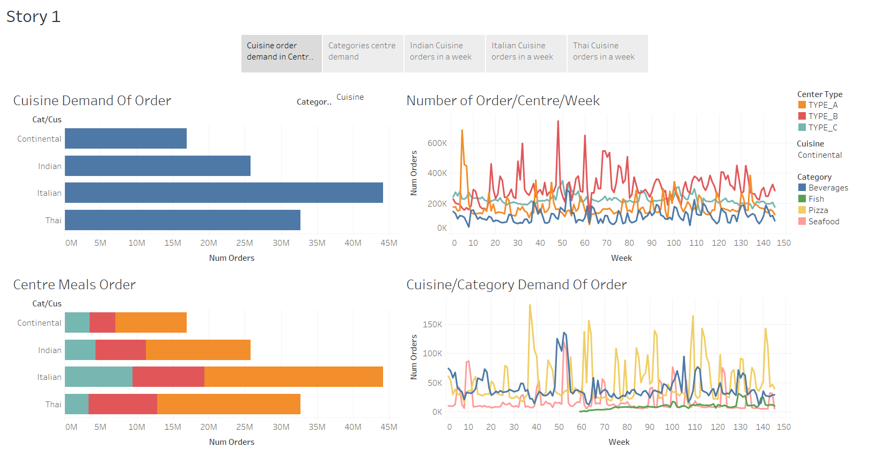

Slide 3
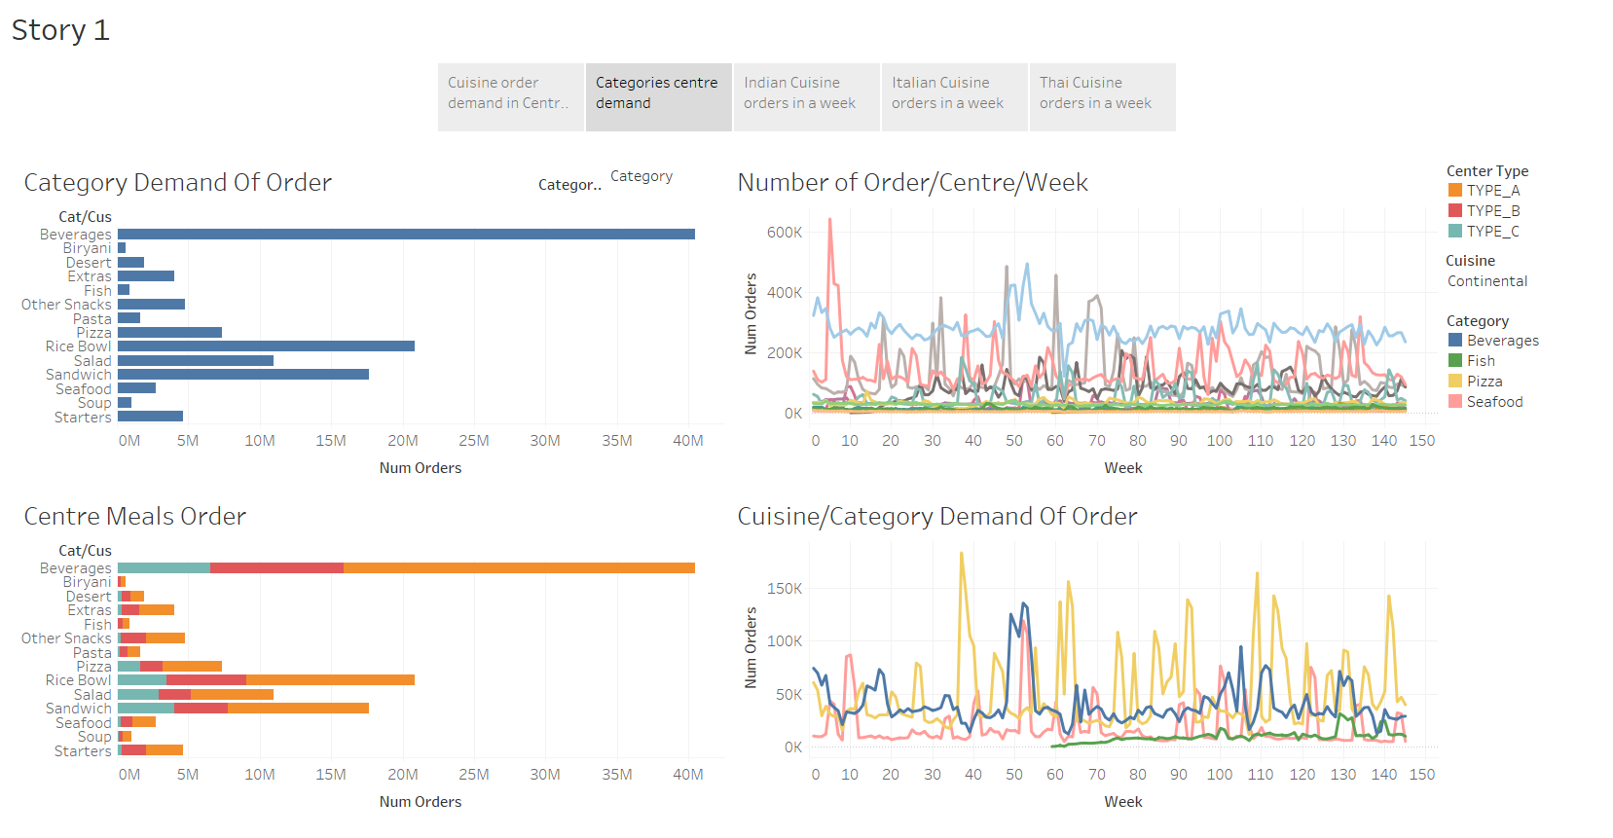

Slide 4
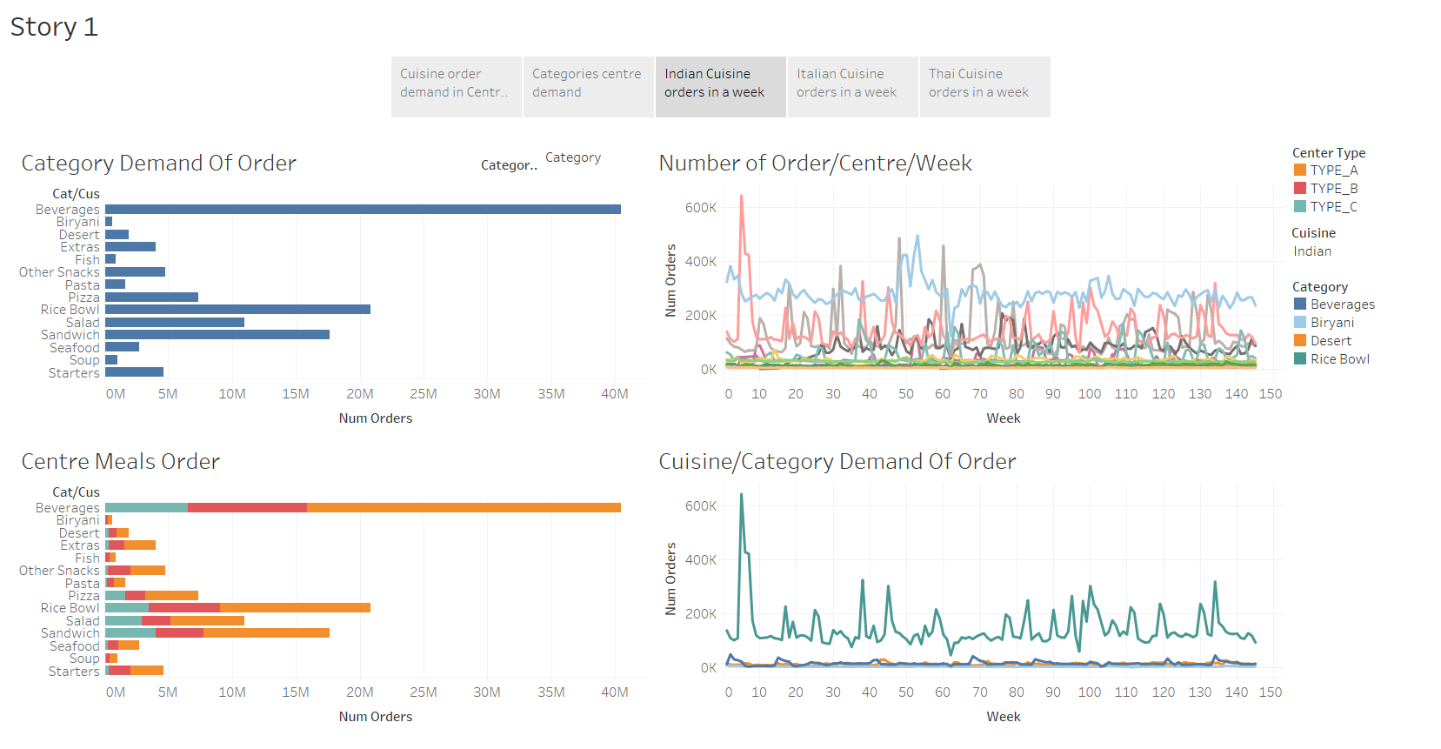

Slide 5
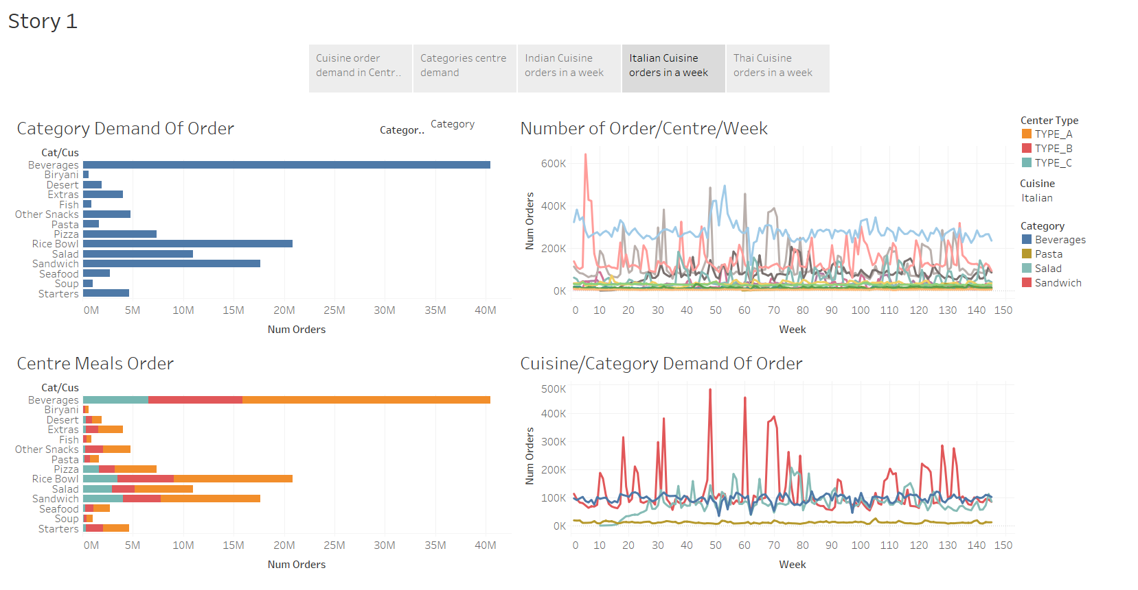

Slide 6
